Slide 1

Speed of sound
In air: ~340 m/s
  v = 331 + 0.60 x T
  ~1100 ft/s
  About 1 mile in 5 seconds (for figuring out the distance to a lightning strike)
In solids: much faster
  (see Table 12.1)

Slide 2
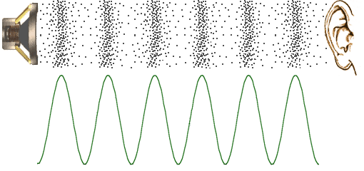
Longitudinal wave

Slide 3
Audible range for humans
What does “frequency” mean?
What is a “Hertz?”

Slide 4
Audible range for humans
Hearing Test

Slide 5
Audible range for humans
Roughly 20 Hz to 20,000 Hz

Slide 6
Logarithms
What is the logarithm of 100?
What is the logarithm of 10,000?
What is the log 10⁵/10²?
What is the log of 2?
What is the log of 200?

Slide 7
Intensity of wave
Waves carry energy. It is energy that is transported, not the material through which the wave travels.
Intensity is in watts per square meter.

Slide 8

Intensity of wave
Let’s say that at a distance of 1.0 m from an explosion, the intensity is 4 x 10⁻⁴ W/m².
How much energy passes through an entire sphere of 1.0 m radius in 1 sec?
What is the intensity 2.0 m from this explosion?
Notes:
Needs “area” squares, 1 for the inner sphere that then spreads out to make four on the outer sphere.

Slide 9
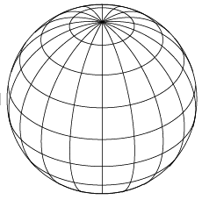
Intensity of wave
Notes:
Needs “area” squares, 1 for the inner sphere that then spreads out to make four on the outer sphere.

Slide 10
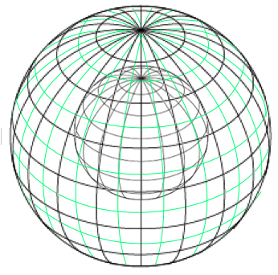
Intensity of wave
Notes:
Needs “area” squares, 1 for the inner sphere that then spreads out to make four on the outer sphere.

Slide 11
Amplitude and Intensity
Loudness (our perception) increases roughly with the logarithm of the actual amplitude of sound waves, which is the maximum distance a molecule moves from its undisturbed location.
Therefore, we hear an increase of 10 times in the intensity as about the same across the audible spectrum no matter whether it’s a soft sound increasing 10 times or a very loud sound increasing by a factor of 10.

Slide 12


Sound level and Intensity
Sound level is a measure of how loud something sounds to us.
Unit of sound level: decibels

Slide 13
Sound level and Intensity
Calculating sound level:
  in a quiet restaurant

Slide 14

Sound level and Intensity
Calculating sound level:
  based on what we hear at 1000 Hz

Slide 15
Amplitude and Intensity
If one source of sound creates an intensity I₀, then two identical sources create intensity 2 I₀.
I is proportional to the number of identical sources.

Slide 16
Sound level and Intensity
All dB values for sounds are the result of ratios of observed sound intensity to the standard (threshold of hearing) intensity.

Slide 17
Sound level and Intensity
An increase in sound level of 10 dB is a factor of 10 increase in intensity.
Therefore, a sound that is 30 dB louder than another is 3 factors of 10 more intense than the other (10x10x10 = 1000)!
70 dB is 1000 times the intensity of 40 dB.

Slide 18
Sound level and Intensity
Calculating sound level:
  for the user of a vacuum cleaner

Slide 19
Sound level and Intensity
How much does dB level increase if intensity goes up by a factor of 10?

Slide 20
Sound level and Intensity
How much does dB level increase if intensity goes up by a factor of 10?
  If the intensity increases by a factor of 10, then the sound level in dB increases by 10.

Slide 21
Amplitude and Intensity
How much does dB level increase if intensity goes up by a factor of 10?
  The intensity increases by a factor of 10, so the sound level in dB increases by 10 dB.
  Therefore an 80 dB sound is 10 times more intense than a 70 dB sound.

Slide 22
Sound level and Intensity
How much does dB level increase if intensity goes up by a factor of 100?

Slide 23
Sound level and Intensity
Sound 1 has a loudness (aka sound level) of 50 dB. Sound 2 has 100 times the intensity of Sound 1. How loud is Sound 2?
  70 dB

Slide 24
Sound level and Intensity
Sound 1 has a loudness of 80 dB. How many times more intense is Sound 1 than Sound 2, which has a loudness of 50 dB?
  1000 times more intense.

Slide 25
Sound level and Intensity
How much does dB level increase if intensity goes up by a factor of 10?
  If the intensity increases by a factor of 10, then the sound level in dB increases by 10.
  An 80 dB sound is 10 times more intense than a 70 dB sound.
  A 90 dB sound is 100 times more intense than a 70 dB sound.

Slide 26
Sound level and Intensity
How much does dB level increase if intensity goes up by a factor of 2?

Slide 27
Sound level and Intensity
A trumpet plays a note that has a certain intensity and creates for you a sound level of 70 dB.
  How many trumpets would you need to increase the intensity by 10 times?
  If you do increase the intensity by 10 times, what will be the new sound level that you hear?

Slide 28
Sound level and Intensity
A trumpet plays a note that has a certain intensity and creates for you a sound level of 70 dB.
  How many trumpets would you need to increase the intensity by 2 times?
  If you do increase the intensity by 2 times, what will be the new sound level that you hear?

Slide 29
Sound level and Intensity
A choir has 32 members and you hear an average sound level of 85 dB when they sing “Mary Had a Little Lamb.”
The choir splits in half. What sound level would a half choir produce?
It splits in half again. Now how loud?
How many singers would be needed to reach 95 dB?

Slide 30
Intensity and Distance
A jet engine produces a sound level β of 130 dB when you are 30 m away. How far away do you have to be in order for the sound level β to decrease to 110 dB?

Slide 31
Intensity and Distance
A jet engine produces a sound level of 130 dB when you are 30 m away. How far away do you have to be in order for the sound level to decrease to 110 dB?
  Answer: about 300 m, 10 times farther
    A drop of 20 dB means a drop of 10 X 10 in intensity. Then use inverse square law.

Slide 32
Sound level and distance
A conversation occurring 1.0 m away from you has a loudness of 60 dB.
  How loud in dB would 10 conversations 1.0 m away from you be?
  How loud would 1 conversation occurring 10.0 m away from you be?

Slide 33
Resonance
Resonance is all about timing of a wave that bounces back and forth in a medium. A properly timed wave will build itself up (i.e. “reinforce” itself) in the medium in which it is reflecting back and forth.
A poorly timed wave will cancel itself out at least as much as it reinforces itself, so it never builds itself up.

Slide 34
Resonance & Standing Waves
http://www.glowscript.org/#/user/pgswack/folder/My_Programs/program/Wave_on_a_string
Standing longitudinal waves
Notes:
At this point hand work on standing wave assignment

Slide 35
Fundamental
noun: fundamental frequency; plural noun: fundamental frequencies
the lowest frequency produced by the oscillation of the whole of an object, as distinct from the harmonics of higher frequency.
  We find it in our computer model from the shortest period required for a new wave to reinforce an old wave. The fundamental frequency is the reciprocal of this period.

Slide 36
Musical “pipes”
Open-open
  What harmonics exist?
  Sketch standing wave diagrams.
Open-closed
  What harmonics exist?
  Sketch standing wave diagrams.
No closed-closed instruments. I wonder why?

Slide 37
Harmonics
“Harmonic” is defined as an integer (whole number) multiple of the fundamental frequency.

Slide 38
Harmonics
A bugle or natural trumpet may be modeled as a tube which is open at both ends. The most commonly used notes in a bugle are G, C, E, and C. The frequencies of the G and the lower C of these four notes are 392 Hz (G) and 523 Hz (C), and there are no notes possible between these two frequencies. If the speed of sound in the air in the tube is 343 m/s, what length of tube is needed to produce these notes?
Notes:
Because the two frequencies are consecutive harmonics, the difference between them is the fundamental. That is 131 Hz. That corresponds to a wavelength of 2.62 m. An open tube of half a wavelength will resonate at its fundamental. Half of 2.62 m is 1.31 m. That’s the answer. Thus, the G and C happen to be the 3rd and 4th harmonics of this 1.31 m tube.

Slide 39
Harmonics
Louis-Victor de Broglie proposed that the separate orbits of the hydrogen atom proposed by Niels Bohr could be explained by his idea that electrons could be represented by waves instead of particles. Each orbit would accommodate a whole number of wavelengths of an electron.

Slide 40
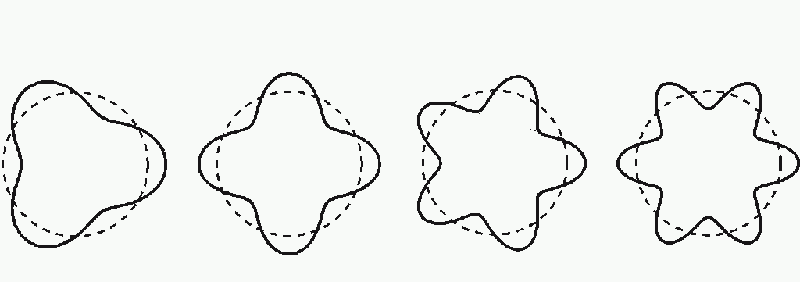
Harmonics in the H atom

Slide 41
Beats
Ripple simulation shows beats as the result of the interference of waves from two sound sources.

Slide 42
Beats
Undertones are produced when beats are in the audible frequency range.
Play 400 Hz and 300 Hz and you get a 100 Hz undertone that you can hear as well!
Notes:
Audacity ’Undertone.aup’

Slide 43
Doppler Effect
Applets
file:///Users/Gregg/Documents/1.Harper/03PHY121/Ch12Sound/Doppler%20effect.webarchive
http://www.astro.ubc.ca/~scharein/a311/Sim/doppler/Doppler.html
file:///Users/Gregg/Documents/1.Harper/03PHY121/Ch12Sound/Applet:%20Doppler%20Effect.webarchive
http://www.lon-capa.org/~mmp/applist/doppler/d.htm

Slide 44
Doppler Effect
When a source of sound approaches us we hear a frequency higher than is being emitted.
When a source of sound recedes from us we hear a frequency lower than is being emitted.
This is called the Doppler Effect.

Slide 45
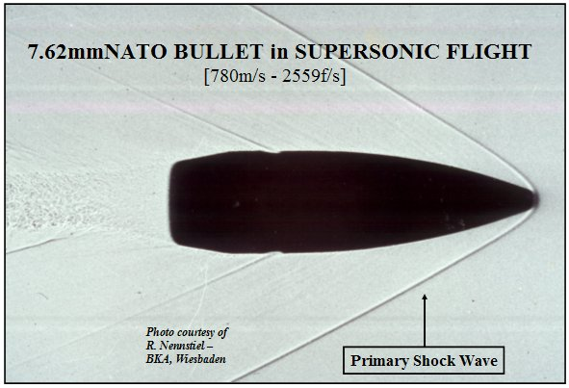
Shock Waves

Slide 46
Shock Waves

Slide 47
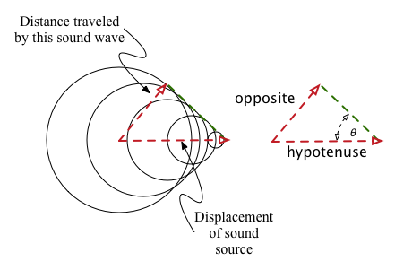

Shock Waves

Slide 48
Doppler Effect
How do we explain the Doppler Effect when the source moves?
  The source emits, say, a compression. During the subsequent period, this source moves forward, so the next compression is not as far behind the previous compression compared to the case when the source is not moving.
  http://www.lon-capa.org/~mmp/applist/doppler/d.htm

Slide 49
Doppler Effect
How far does a sound wave travel during a time interval of one period, T?

Slide 50
Doppler Effect
How far does a sound wave travel during a time interval of one period, T?
  one full wavelength (by definition)

Slide 51

Doppler Effect for moving source
How far does the source of sound travel during a time interval of one period, T?
  That tells you how much the wavelength is reduced in the forward direction….and lengthened in the backward direction.

Slide 53
Doppler Effect
Note that the speed of sound does not change. It is still about 340 m/s.
Therefore, the frequency heard will increase or decrease, depending on whether the source approaches or recedes. Use v = fλ to find f.

Slide 54
Doppler Effect for moving observer
How do we explain the Doppler Effect when the observer moves toward the source?
  The observer receives, say, a compression. Before receiving the next compression, the observer moves forward toward the source, so the next compression hits the observer sooner compared to the case when the observer is not moving.
  http://www.phys.uconn.edu/~gibson/Notes/Section6_3/Sec6_3.htm

Slide 55
Doppler Effect for moving observer
How do we explain the Doppler Effect when the observer moves?
  The observer travels from one compression to the next as the compressions move along, too. The time needed to do this depends on λ, the actual distance from one compression to the next, and the speed the observer travels relative to the sound waves from one compression to the next, which is

